Slide 2
HISTOPATHOLOGY of METASTATIC BREAST CANCER
FAKHRJOU. A
PROFESSOR OF PATHOLOGY
TABRIZ UNIVERSITY OF MEDICAL SIENCES
1400/03/27

Slide 3
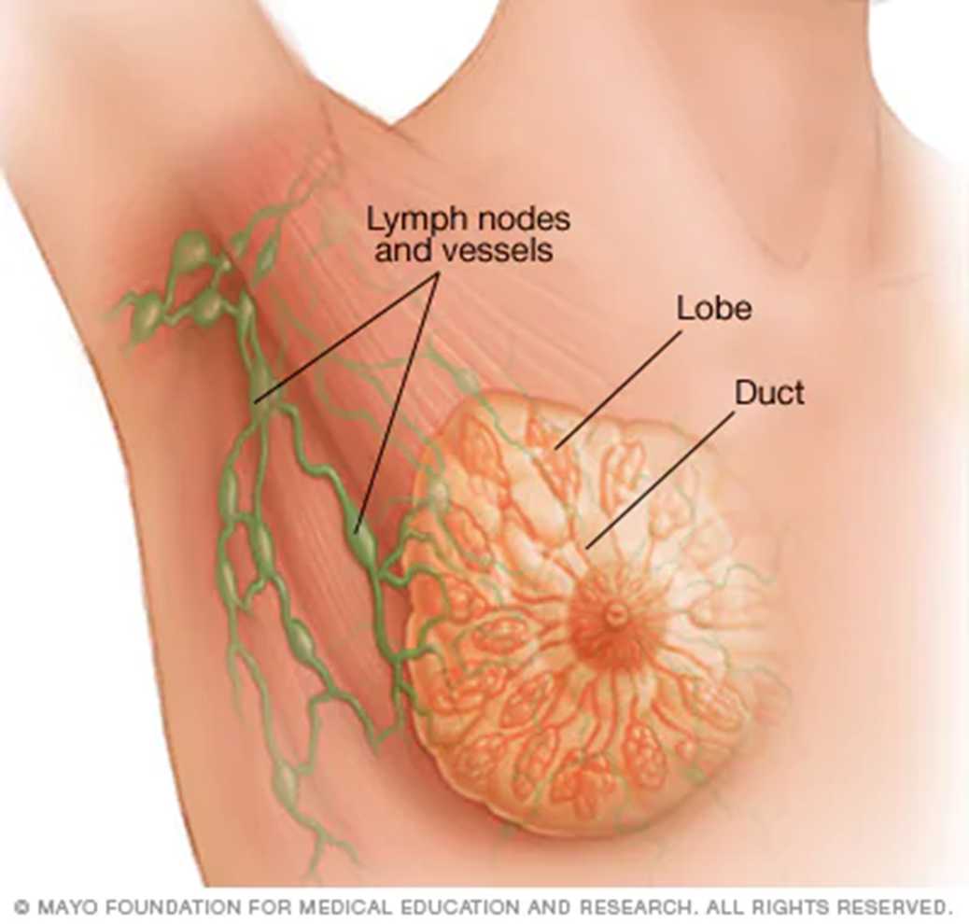
Breast carcinoma spreads by direct invasion:
by the lymphatic route,
by the hematogenous route.

Slide 4
Lympatic involvement:
PN0i :- <0.2mm metastases (single cells or isolated tumour cell clusters)
Isolated tumour cells (ITCs)
Are small clusters of cancer cells less than 0.2 mm across, or a single tumour cell, or a cluster of fewer than 200 cells in one area of a lymph node. Lymph nodes containing only isolated tumour cells are not counted as positive lymph nodes

Slide 5
pN1mi:- micrometastases 0.2-<2mm diameter
pN1mi means one or more lymph nodes contain areas of cancer cells called micrometastases that are larger than 0.2mm. Or the nodes contain more than 200 cancer cells but are less than 2mm. pN1a metastases >2mm diameter (1-3 positive nodes).

Slide 6
N1b Internal mammary SNL positive not clinically apparent pN1c Internal mammary SNL +ve (clinically occult) plus 1-3 axillary nodes +ve. pN2a 4-9 axillary nodes +ve. pN2b Internal mammary nodes +ve on micro and clinically. pN3a >10 axillary nodes +ve or infraclavicular nodes +ve pN3b complicated pN3c Supraclavicular node +ve

Slide 7
Ipsilateral axillary, ntermammary, Intrenal mammary and supraclavicular lymph nodes are considered regional nodes, not distant and are part of pathologic nodal staging of the primary tumor (pN).
Cervical, contralateral internal mammary and contralateral axillary lymph nodes are distant metastases (pM1)

Slide 8
Some of these metastases are already present at the time of diagnosis, and others become manifest clinically months, years, or decades after initial diagnosis and treatment.

Slide 9
The two lymph node stations typically involved by metastatic breast carcinoma are :
1/ Axilla with the supraclavicular area representing an extension.
2/ Internal mammary chain which lies at the anterior ends of the intercostal spaces by the side of the internal thoracic artery.
It should be remembered that it is not too unusual also to find lymph nodes within the substance of the mammary gland (“intramammary lymph nodes”).

Slide 10
The overall incidence of metastatic involvement of this chain in patients with clinically detectable axillary lymph node metastases is approximately 20%.
Rarely, a metastatic lymph node will appear entirely necrotic and may simulate an infectious process; immunostains for keratin may be useful in aiding detection of necrotic tumor cells.

Slide 11
Axillary lymph node metastases are present
in approximately are divided into levels according
to their topographic relation with the insertion of the pectoralis
minor muscle:
1/ Low or Proximal,
2/ Medium,
3/ High or Distal.
When extensively involved by metastatic carcinoma, the axillary lymph nodes are palpable, but the margin of error with clinical examination
is high.

Slide 12
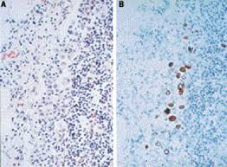
Sentinel Lymph node node Micrometastatic disease
Section prependicular to the long axis at 2-mm intervals, examin with H&E and CK

Slide 13
The main recognized types of inclusion are heterotopic breast epithelium (which demonstrain Rosen’s Breast Pathology textbook, the author references situations in which it is difficult to distinguish benign glandular inclusions from metastatic carcinoma and states that “metastasis derived from a primary breast carcinoma can only be excluded in this circumstance if a mastectomy is performed and the specimen is thoroughly studied.
An intact myoepithelial layer cells are p63+ and smooth muscle myosin+ indicates benign inclusion of Breast glands.

Slide 14
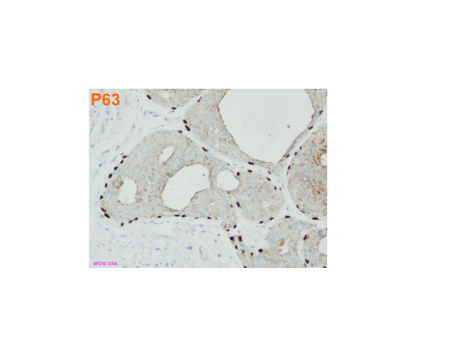

Slide 15
Local invasion can occur into the nipple, skin, pectoralis fascia and muscle, or other structures of the chest wall.
Distant metastases are seen most commonly in the:
Skeletal system
Lung and pleura
Liver
Ovary
Adrenal gland
Central nervous system (including leptomeninges and eyes)

Slide 16
And vary according to breast cancer subtype, with the hormone receptor– positive, HER2-negative subtype having a higher rate of lymph node metastasis at diagnosis than the triple negative subtype. Invasive lobular carcinoma (including the signet ring variant) has a propensity to metastasize to the abdominal cavity, particularly to the gastrointestinal tract, ovaries, and serosal surfaces.

Slide 17
LIVER METASTASIS
Desmoplastic Growth Pattern: the tumor is separated from the liver parenchyma by a band of fibrous tissue, which contains tumor infiltrating lymphocytes. The tumor permeates between the liver hepatocytes, without disruption of the normal architecture. The tumor expands and compresses the surrounding hepatocytes. And look like Cirrhosis.

Slide 18
Diagosic confirmation requires
The use of a panel: CK7+, GCDFP15+, Mammoglubin +, ER+, CK20-,
GCDFP15 is the most specific marker of breast carcinoma but weak/ equivocal is not helpful
Mammaglobin is a more sensitive marker of breast carcinoma than GCDFP15.
Mammaglobin is positive in 40% of endomerial carcinoma and some Melanomas.
GCDFP15 and are positive in Salivary gland carcinoma and skin Adenexal tumor.
Up to30% of breast carcinoma are negative for GCDFP15 and Mammaglobin.

Slide 19
“Pinker” areas of lymph node may represent nodular or diffuse involvement by metastatic lobular carcinoma. Metastatic cells are slightly larger than the background lymphocytes with slightly more pale or pink cytoplasms. Eosinophilia may also be due to accompanying collagen fibrosis.
LOBULAR CARCINOMA

Slide 20
Dispersed single cells. These may blend almost imperceptibly
with the surrounding nodal tissue and can be confirmed
by keratin staining.
Immunostaining for keratin is helpful and sometimes essential in confirming or refuting the presence of lobular carcinoma in lymph .
While keratin staining of sentinel lymph nodes is no longer routinely performed in most centers, keratin staining of nodes in the setting of lobular carcinoma should be considered, especially when There is histologic difficulty in discerning histiocytes from potential lobular carcinoma.

Slide 21
Microscopic (histologic) description
Metastatic tumors often resemble the morphology of the primary tumor
Only the stromal component of a malignant phyllodes tumor will metastasize and morphologically resembles a primary sarcoma

Slide 23
Metastatic lobular carcinoma

Slide 26
ER

Slide 27
Basal-like tumors have higher rates of brain, lung and distant nodal metastases than liver and bone.
Malignant phyllodes tumors and primary sarcomas of the breast have a propensity to metastasize to lungs, bones and liver.
ER+ tumors often recur after long periods and have a propensity to first metastasize to bone

Slide 28
Receptor status in distant metastases often changes from the original primary tumor receptor status
(J Natl Cancer Inst 2018 Jan 5 [Epub ahead of print]):
Estrogen receptor (ER):
22.5% positive primary to negative in the metastasis
21.5% negative primary to positive in the metastasis
Progesterone receptor (PR):
49.4% positive primary to negative in the metastasis
15.9% negative primary to positive in the metastasis
HER2:
21.3% positive primary to negative in the metastasis
9.5% negative primary to positive in the metastasis

Slide 29
Positive stains
GATA3: 96% of non triple negative tumors and 63 - 87% of triple negative tumors, depending on antibody clone (Appl Immunohistochem Mol Morphol 2016;24:609)
CK7, GCDFP-15: 69% of non triple negative tumors and 10% of triple negative tumors
Mammaglobin A: 61% of non triple negative tumors and 17% of triple negative tumors
SOX10: 38% of triple negative tumors; rarely positive in non triple negative tumors

Slide 30
In the presence of metastatic deposits of unknown source to lung and other sites, immunoreactivity for breast markers GCDFP-15, mammaglobin, GATA3, as well as hormone receptors, strongly suggests a breast primary.
Sometimes clinical presentation and imagings are infavour of Sarcoidosis and aggregation of neoplastic cells in the lymph nodes resemble granuloma misinterpreting sarcoidosis.
Metastases of breast carcinoma to the Ovary are likely to be positive for the aforementioned breast markers and negative for WT1, CA125, and PAX8, whereas the reverse is true, with the exception of ER, for primary ovarian carcinoma.

Slide 31
The pattern of metastatic spread of breast carcinoma as evaluated by Fisher in a large randomized series of patients treated with various modalities brought them to the following conclusions:
there is no orderly pattern of tumor dissemination; regional nodes are ineffective as barriers to tumor spread and, when positive, are more an indicator of a particular host–tumor relationship than the instigator of distant metastases;

Slide 32
Gastric:
Distinguish from primary diffuse gastric cancer
(many cases E-cadherin negative).
ER strongly positive in lobular carcinoma, rarely weakly positive in gastric .
GATA3 positive in 5% of gastric cancers (unspecified
type) and 0/32 signet ring gastric carcinomas in a
tissue microarray study.
Mammaglobin and GCDFP-15 negative in signet ring
gastric cancer in a tissue microarray study .
CDH17 and CDX2 may be positive in gastric,no specific gastric carcinoma markers.
Gastric carcinoma commonly CK7+ (non-discriminator).

Slide 33
Gynecologic: metastatic lobular breast cancer can insinuate
in cellular ovarian or endometrial stroma and be very
hard to detect.
Keratin staining may be necessary to demonstrate the
population of diffuse single cells within stroma and
correctly score other immunostains against the ER+
cellular background.

Slide 34
ER is often positive in both and is not useful.
PAX8 useful gynecologic marker.
WT-1 stains ovarian carcinomas, but also 1–8% of breast cancers .
Mammaglobin positive in up to 40% of endometrial and ovarian carcinomas, mandating caution ; smaller proportions stain with GCDFP-15 (5–10%) .
Gynecologic carcinoma commonly CK7+ (non-discriminator).

Slide 35
Urothelial:
metastatic lobular carcinoma must be distinguished
from plasmacytoid or signet ring urothelial carcinomas
GATA3 is frequently positive in urothelial carcinomas
and is not useful in this differential, including signet
ring and plasmacytoid variants .
GATA3 also stains paraganglia .

Slide 36
Bone marrow:
Obvious tumor infiltrate replacing marrow elements. Lobular carcinoma with
mucin vacuoles with nearby osteoclasts .
Keratin staining is useful.
Sometimes the carcinoma can only be appreciated with keratin stains.

Slide 37
Isolated tumor cells have minimal clinically significance currently.
Therefore, the routine use of immunohistochemistry to detect isolated tumor cells is not recommended.

